Slide 1
Pitt Business Alumni-Connect Instructions for Alumni Who Do Have an Existing Handshake Account

Slide 2
Step 1: Adding Your Preferred Email
Pitt Business Alumni-Connect is done through Handshake
If you no longer receive emails from Pitt, add your preferred email to whatever device you wish to use for students to reach out to you
https://www.technology.pitt.edu/help-desk/how-to-documents/email-read-pitt-email-outlook-your-phone-or-tablet
OR, contact Katie Fives, Career Development Assistant, and notify her which email address you prefer to be notified at when you receive a student message on Handshake (contact information: kaf226@pitt.edu)

Slide 3
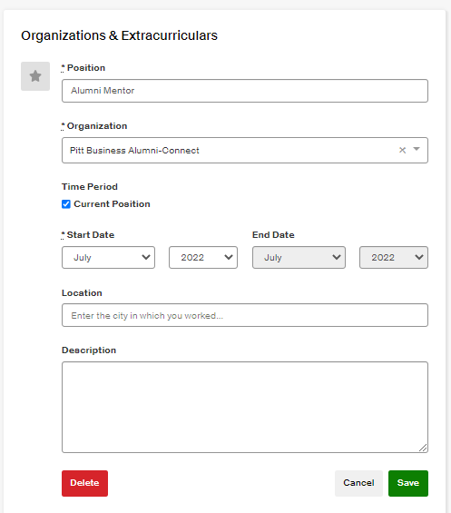
Step 2: Updating Your Profile
Log into Handshake > Update the “Organizations & Extracurriculars” section on your profile
Please update the “Organizations & Extracurriculars” section with the following information:
‘Position’ –> “Alumni Mentor”
‘Organization’ –> “Pitt Business Alumni-Connect” (*Please be sure to type this in exactly as shown. Otherwise, students will not be able to find you on Handshake.)
Check the box that says ‘Current Position’
Select your ‘Start Date’
Click ‘Save’ shown in green

Slide 4
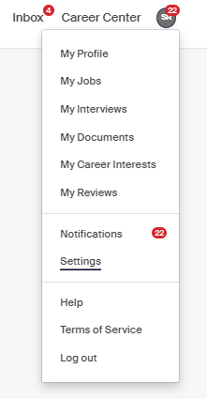
Step 3: Updating Your Profile & Settings
Update your Handshake profile
Be sure to include relevant and up to date information on your profile
Including adequate information on your profile will help students learn more about you as they search for alumni to connect with
Be sure to include a profile picture too
Change your ‘Privacy Settings’
Navigate to the ‘Settings’ tab
Scroll down to the ‘Privacy’ section
Select ‘Community’
This will ensure that students will be able to find and view your Handshake profile

Slide 5
Next Steps
Your profile is complete!
Students will do the initial contacting through Handshake messages
Watch for messages on Handshake from students
You can also receive emails from Handshake that will notify you when someone messages you
At that point, it is up to you if you wish to move the conversation to your email or personal phone
Please view the Pitt Business Alumni-Connect Student & Alumnus Handbook found on the Pitt College of Business Administration website for guidelines of what to do next once a student reaches out to you
The handbook can be found using this URL: https://cba.pitt.edu/careers/student-career-development/alumni-connect/

