Slide 1
Pitt Business Alumni-Connect Instructions for Alumni Who Do Not Have an Existing Handshake Account

Slide 2
Step 1: Getting Started
If you don’t have a Handshake account or don’t remember if you have one, that’s okay!
Contact Katie Fives, Career Development Assistant, at kaf226@pitt.edu
Katie will create a Handshake account for you
In your email to Katie, please include the preferred email address that you want to use for your Handshake account
Please make sure that it is an email address you have access to and frequently use

Slide 3
Step 2: Confirming Your Handshake Account
After Katie creates a new Handshake account for you, you will receive email from Handshake with the subject line "You Have Been Invited to Handshake'
Click 'Confirm My Account'
Set your password

Slide 4
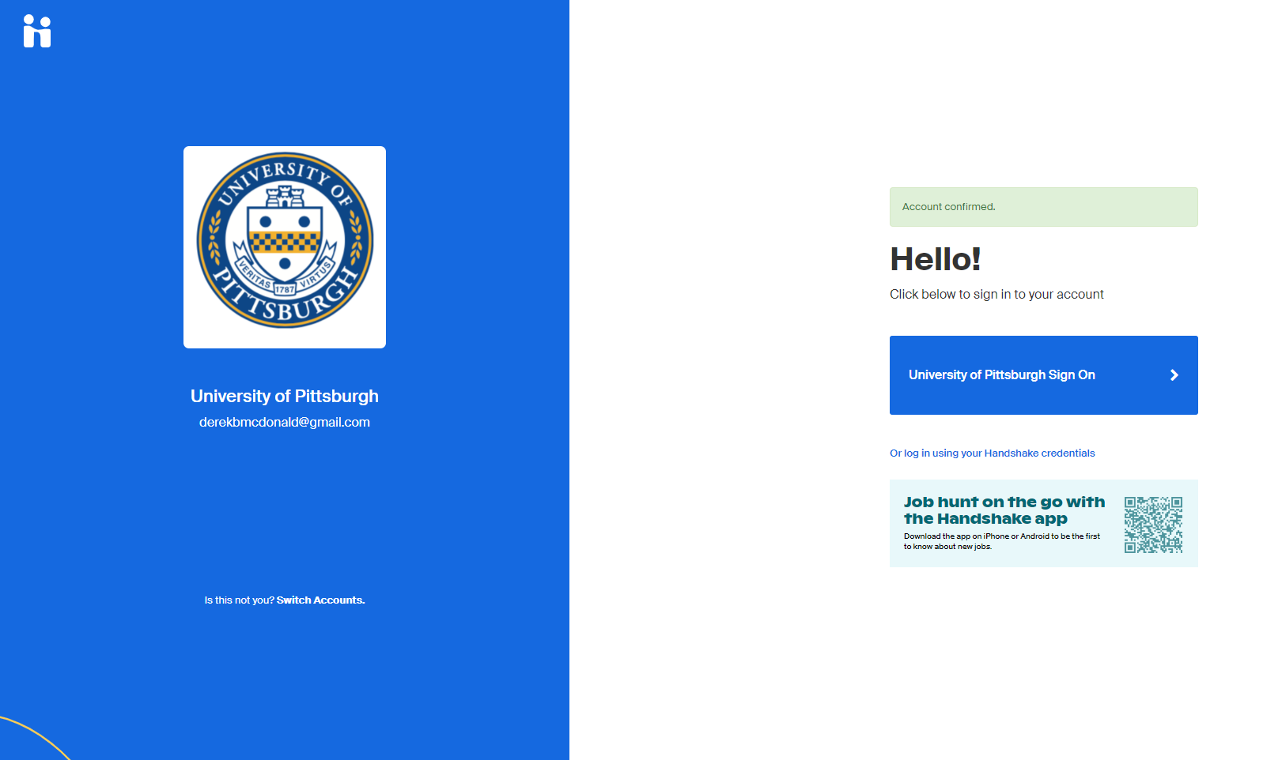
Step 2: Logging into Handshake
Once your password is set, you will see a green bar that says ‘Account Confirmed’
Log in using your information using the link that says ‘Or log in using your Handshake credentials’
Use the email you gave to Katie, not a pitt.edu email
Use the password you just set

Slide 5
Step 3: What to do once in Handshake
Once logged in you will be taken to a welcome screen
Enter the month and year you graduated
Click 'Get Started'
The next screen will ask you to join 'Community' - click 'Done'
*Selecting 'Community' will ensure that the students will be able to view and search for your profile on Handshake

Slide 6
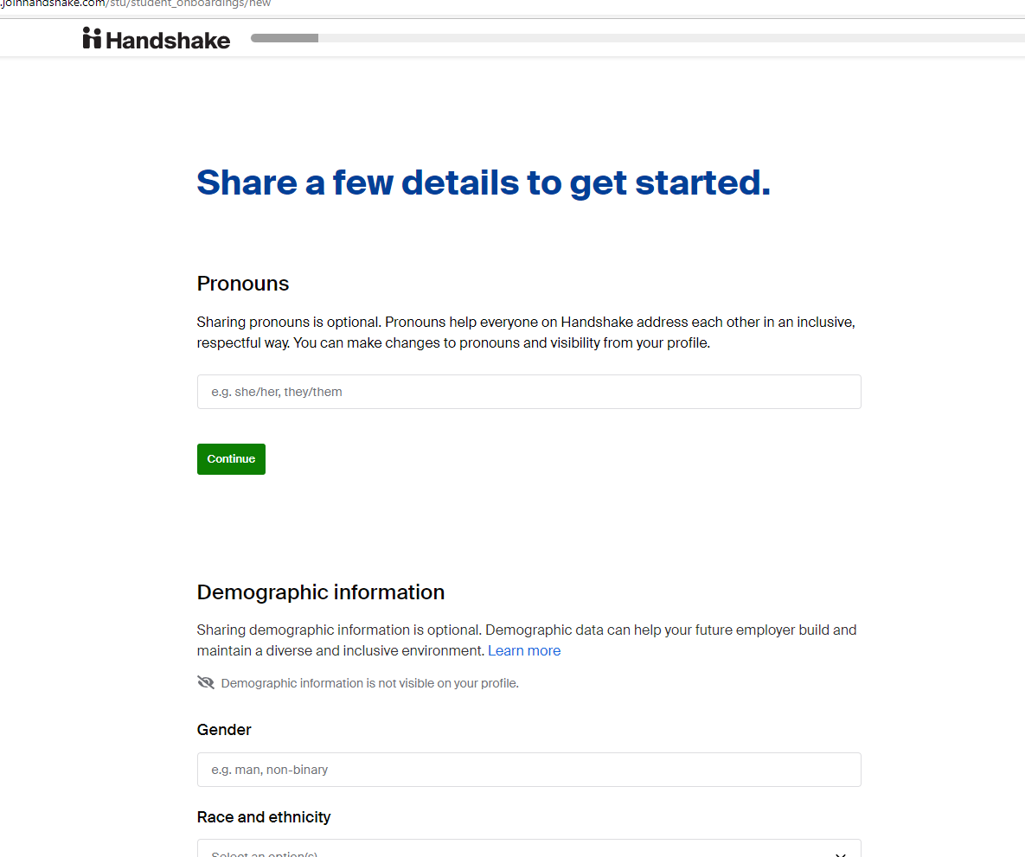
Step 4: Updating Your Profile
At this point you'll be creating your profile
It is up to you how much you want to add or skip. If you want to use Handshake to look for jobs, then add a lot, otherwise, skip down to 'Are you in any clubs or organizations'
Type in “Pitt Business Alumni-Connect”
This will allow students to find you and connect with you
(*Please be sure to type this in exactly as shown. Otherwise, students will not be able to find you on Handshake.)
Click 'Submit' at the bottom of the screen

Slide 7
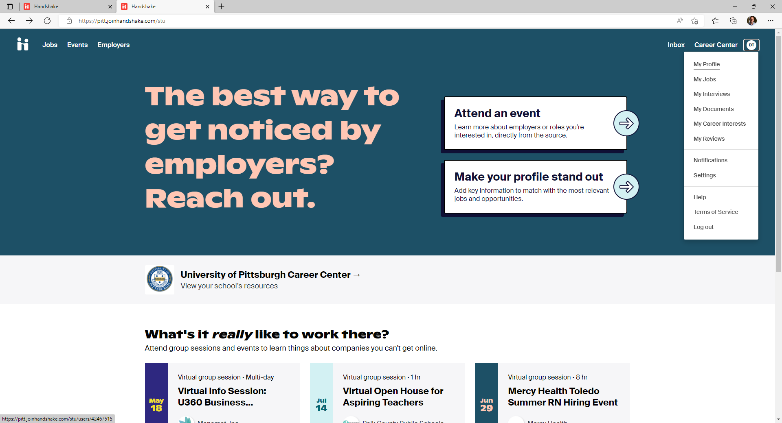
Step 4: Updating Your Profile
You will be taken to the screen on the right
To add your work experiences, click on the initials in the top right corner of your screen and click 'My Profile'

Slide 8
Step 4: Updating Your Profile
This screen is like a LinkedIn profile, and you can add as much or as little as you want
The more you add, the more the students can learn about you and decide whether you could both be a good fit for one another
‘Work & Volunteer Experience’ is where you add your past and current work information
You can also upload a resume to make this faster

Slide 9
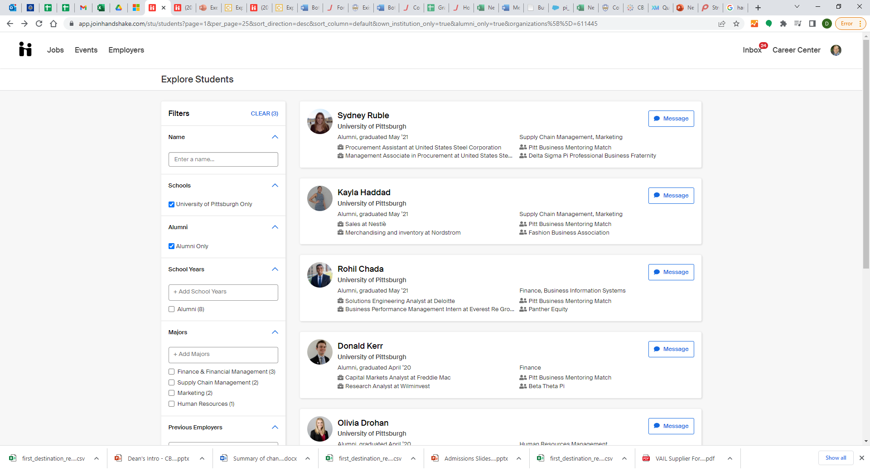
Next Steps
Your profile is complete!
This is what the students will see →
Students will do the initial contacting through Handshake messages
Watch for messages on Handshake from students
You can also receive emails from Handshake that will notify you when someone messages you
At that point, it is up to you if you wish to move the conversation to your email or personal phone

Slide 10
Next Steps
Please view the Pitt Business Alumni-Connect Student & Alumnus Handbook found on the Pitt College of Business Administration website for guidelines of what to do next once a student reaches out to you
The handbook can be found using this URL: https://cba.pitt.edu/careers/student-career-development/alumni-connect/

